Slide 1


I Project Presentation (KCS 851)
KIET Group of Institutions, Ghaziabad
(An ISO – 9001: 2008 Certified & ‘A+’ Grade accredited Institution by NAAC
Guide Name :- Mr. Abhishek Goyal
Team Members :- Avi Chaudhary (2000290120048)
Avika Tyagi ((2000290120049)
Ankita Kushwaha (2000290120026)
Project Id:- PCS24-11

Slide 2
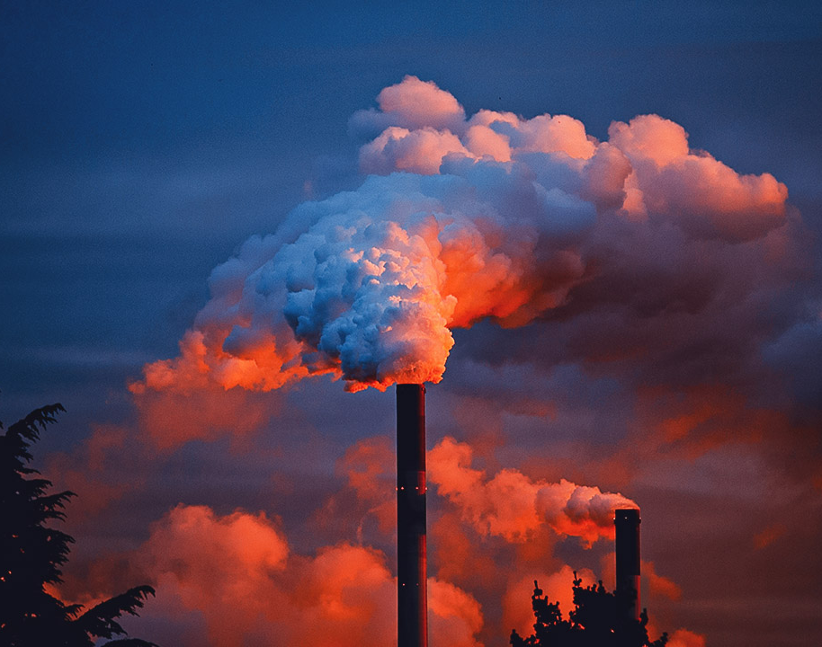
AIR POLLUTION FORECASTING

Slide 3
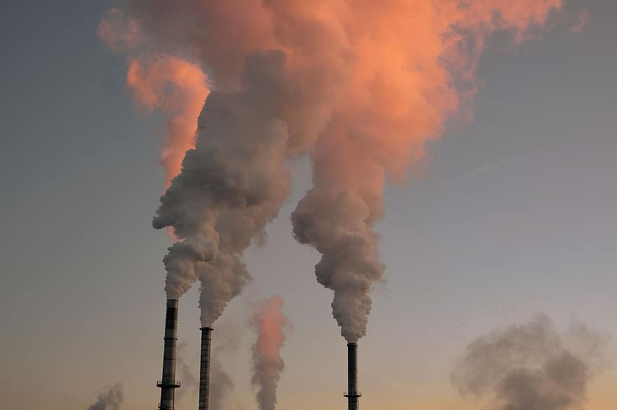
Content:
Problem Statement.
Objectives
Technology Used.
Implementation of Details
Patent status.
Research Paper status
Literature Survey
Workflow Diagram
Project Status
References

Slide 4
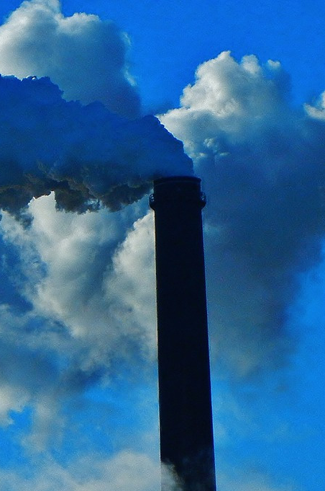
Problem Statement
Air pollution is a significant environmental problem that has adverse effects on human health, climate, and ecosystems.
In recent years, there has been a growing interest in using machine learning algorithms to forecast air pollution levels accurately.

Slide 5

objectives
To develop a machine learning model for air pollution forecasting
To achieve high accuracy in air pollution forecasting
To automate the process of air pollution forecasting
To make the air pollution forecasting system easily accessible and user-friendly.

Slide 6
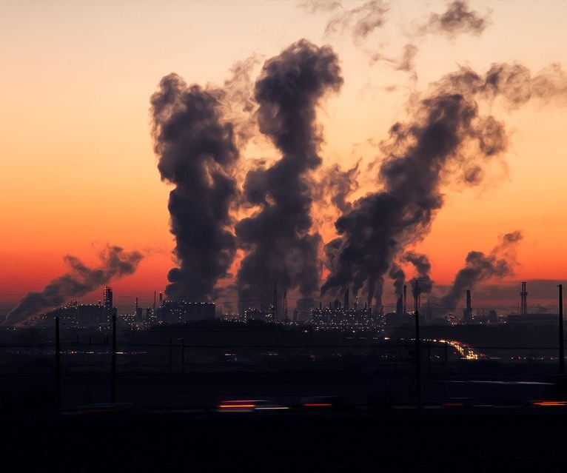
technology used
Data collection and pre-processing tools
Machine learning algorithms - Multi linear regression.
Programming language- Python

Slide 7
Approach:
Data collection: Collecting data related to air quality, weather, and other relevant parameters.
Data pre-processing: Cleaning and processing the collected data to prepare it for machine learning algorithms.
Feature selection: Selecting the most relevant features that impact air pollution levels.
Model training: Developing and training a machine learning model using the selected features.
Model testing: Evaluating the accuracy and performance of the machine learning model.
Deployment: Deploying the machine learning model for air pollution forecasting.

Slide 8
Workflow Diagram
Air pollution data set
Pre Processing
Split the Dataset
Training Dataset
Testing Dataset
Supervised Machine Learning
Prediction of Air quality

Slide 9
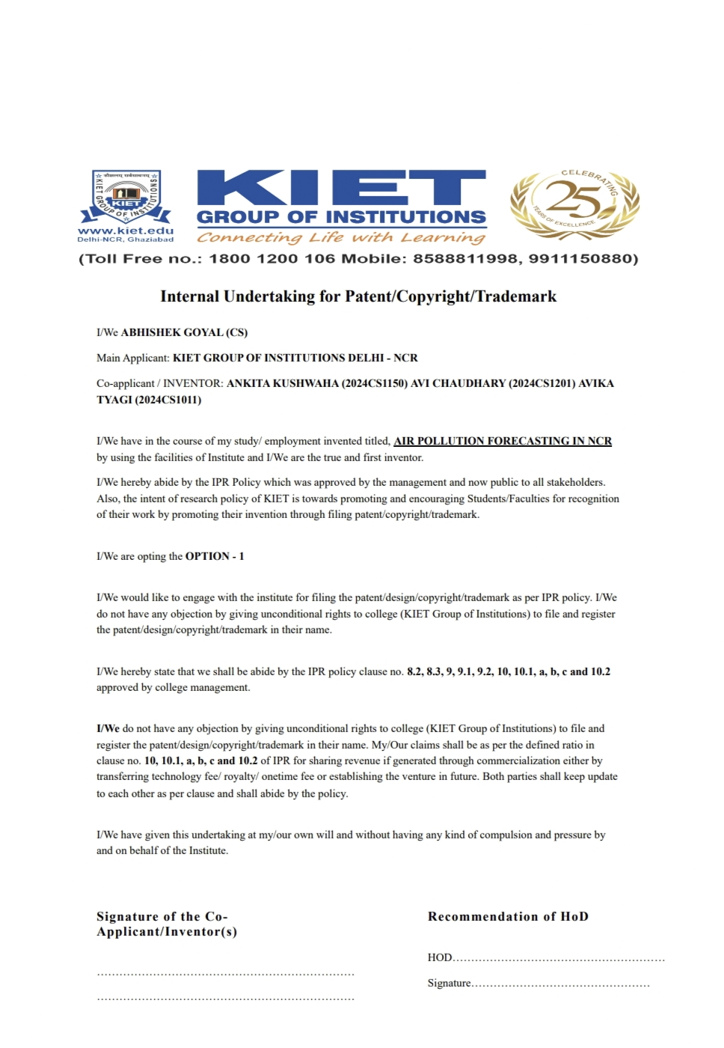
Patent Status

Slide 10
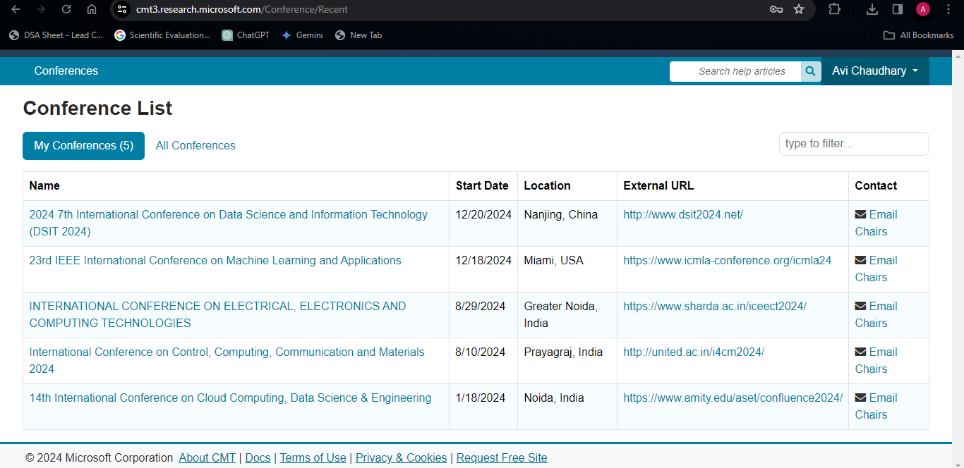
Research Paper Status
Submitted

Slide 11
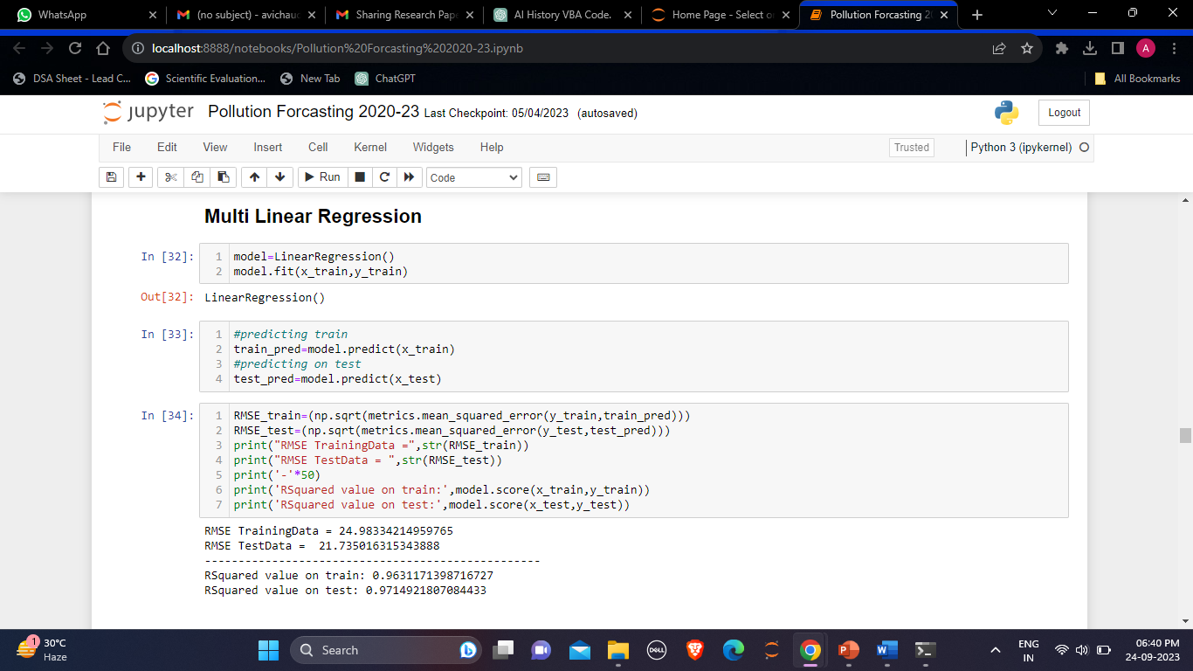
Project Status:
Completed

Slide 12
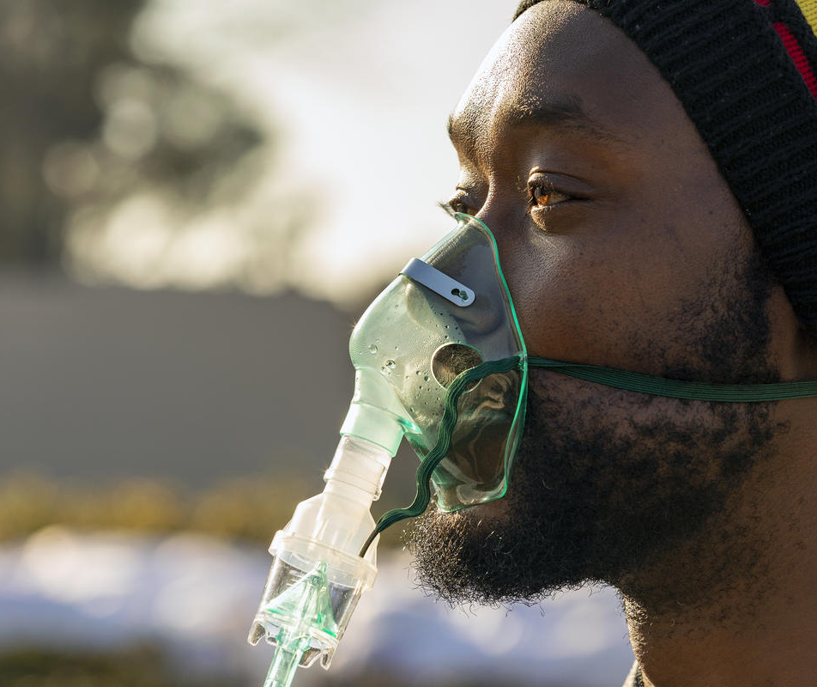
Thank you

